Slide 1







Enterprise Blockchain Developers (Intermediate)
In support of
Powered By

Slide 2
Outline
Fallback Proxy
Docker
Docker Compose
Node js and Express js
© 2017-2020 SmartMesh Foundation Pte. Ltd. | MeshBox Foundation Pte. Ltd.

Slide 3
Docker Overview
What is Docker?
Docker is a tool designed to make it easier to create, deploy, and run applications by using containers.
Docker enables you to separate your applications from your infrastructure so you can deliver software quickly. With Docker, you can manage your infrastructure in the same ways you manage your applications
What does this mean?
mimic all the enviroment, systems in virtural container
we can run the applications in this virtural envirement
this container along with the preinstalled applications can be quickly deployed

Slide 4
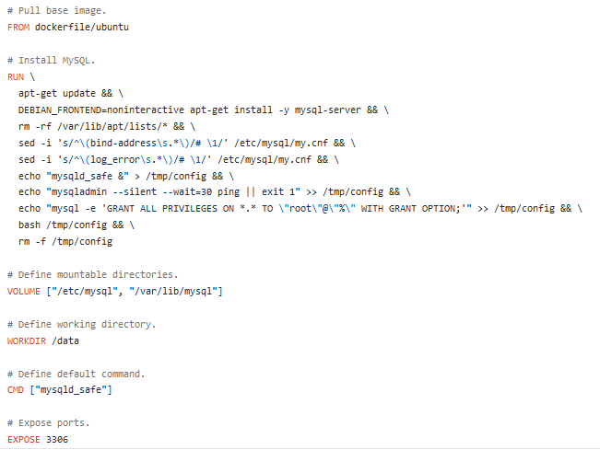
Docker File
Docker file
mysql Docker example: https://github.com/dockerfile/mysql/blob/master/Dockerfile

Slide 5
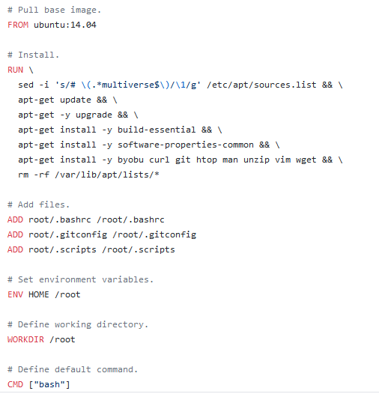
Docker File
Docker file
dockerfile/ubuntu: https://github.com/dockerfile/ubuntu/blob/master/Dockerfile

Slide 6
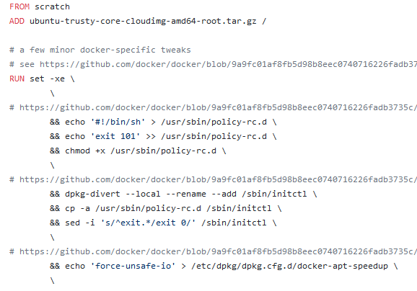
Docker File
Docker file
ubuntu:14.04: https://github.com/tianon/docker-brew-ubuntu-core/blob/ec931883d8292935b62ac40757287491e6ff467e/trusty/Dockerfile

Slide 7
Docker File
Now we come back and think about what the Docker is?
1. reproduce the all the enviroment setting up steps in the virtual container
2. either build it from the source or / upload the local built image to the docker hub for people download and use directly in their Docker file or docker-compose

Slide 8
Docker Command Explain
FROM：initializes a new build stage and sets the Base Image for subsequent instructions.
RUN：instruction will execute any commands in a new layer on top of the current image and commit the results
COPY: copies new files or directories from <src> and adds them to the filesystem of the container at the path
CMD provide defaults for an executing container. CMD executed when docker run; RUN exectued when docker build。
ENTRYPOINT: allows you to configure a container that will run as an executable.
ENV: sets the environment variable <key> to the value <value>
VOLUME: creates a mount point with the specified name and marks it as holding externally mounted volumes from native host or other containers
EXPOSE: expose ports
WORKDIR: sets the working directory

Slide 9

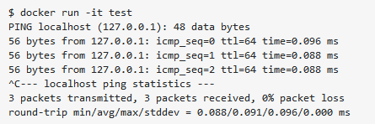
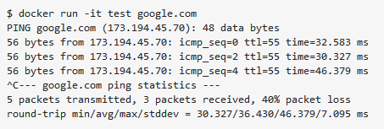
Docker Command Explain
CMD vs ENTRYPOINT
The ENTRYPOINT specifies a command that will always be executed when the container starts.
The CMD specifies arguments that will be fed to the ENTRYPOINT.
no argument
with the argument

Slide 10

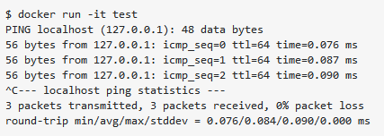

Docker Command Explain
CMD vs ENTRYPOINT
The ENTRYPOINT specifies a command that will always be executed when the container starts.
The CMD specifies arguments that will be fed to the ENTRYPOINT.
no argument
with the argument will override

Slide 11
Docker Compose Overview
What is Docker Compose?
Compose is a tool for defining and running multi-container Docker applications. With Compose, you use a YAML file to configure your application’s services. Then, with a single command, you create and start all the services from your configuration.
Explain the test network docker-compose yaml file
https://github.com/hyperledger/fabric-samples/blob/master/test-network/docker/docker-compose-test-net.yaml
Docker set the enviriment and the applications, docker-compose quickly deploy in the servers
peer node start + all the envirment variable = command line peer node start

Slide 12
Docker Demo
Command Demo
Dockerizing a Node.js web app

